Slide 1
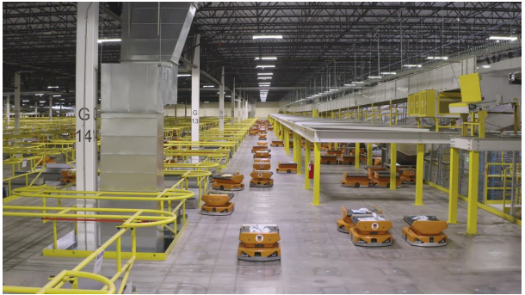
Multi-agent Motion Planning for Non-Holonomic Mobile Robots
Prof. Daniel Flickinger
Presented by- Prasanna Natu
Shreya Bang
Shambhuraj Mane

Slide 2
Project Overview
Motivation: Integration of automation and robotics in Warehousing and Logistics.
Project Goal: Determining the optimal paths for multiple agents (robots) to move within a shared space while avoiding collisions.
Approach: To accomplish this goal, we will be employing a 2D simulation environment (replicating real-world warehouse) and implement ICBS (Improvised Conflict-Based Search) that enables multiple agents to navigate environment, while avoiding collisions.

Slide 3
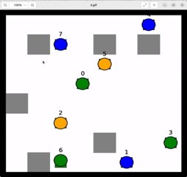
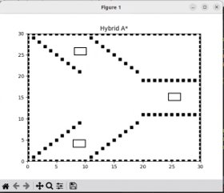
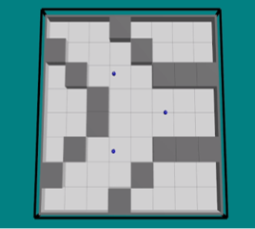
Environmental Setup
Holonomic 2D environment | Non-holonomic 2D environment | ARGoS representation of 2D non-holonomic Environment

Slide 4
Improved Conflict Based Search
This approach builds upon the classic CBS method by incorporating four key strategies: Prioritizing Conflicts, Bypassing Conflicts, Meta-agent handling, and Merge & Restart.
We have implemented the algorithm which employs prioritized conflict resolution and disjoint splitting to enhance the path planning process.
ICBS algorithm is mainly divided in two stages:
High-level algorithm
Low-level algorithm

Slide 5
Methodology
Low-level Algorithm:
We have employed A* algorithm in 2D holonomic grid environment to plan paths for multi agents. A* will be acting as the low-level algorithm for ICBS in holonomic .
However, for considering the non-holonomic approach we implemented to Hybrid A star algorithm.

Slide 6
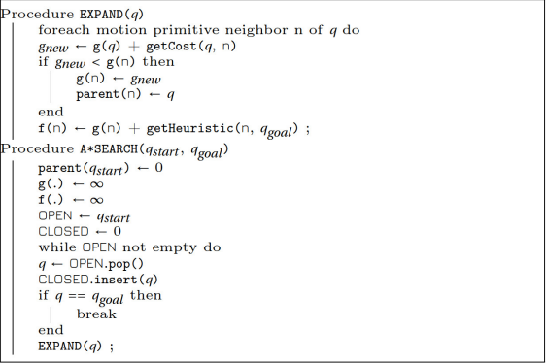
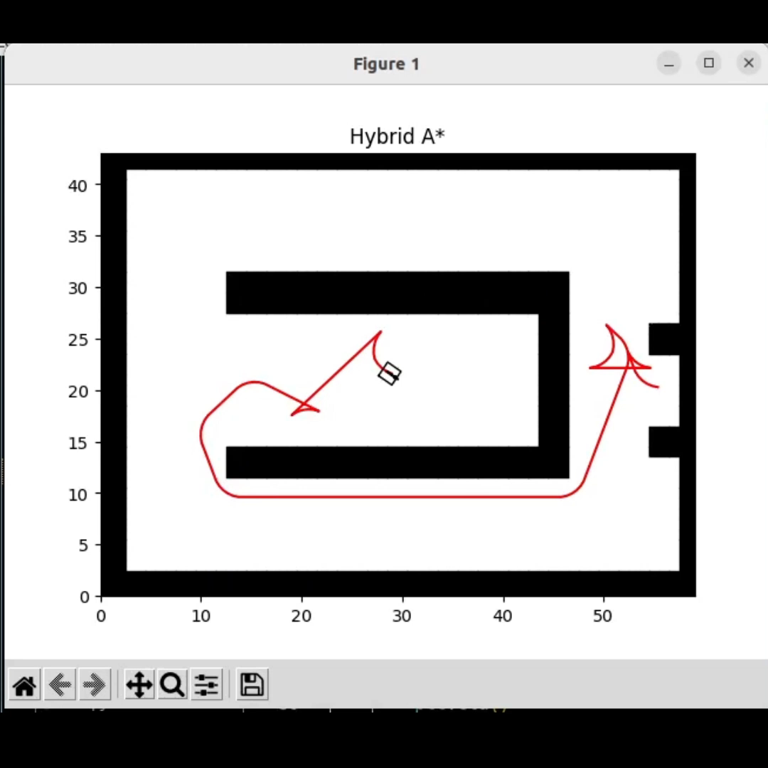
Hybrid A* Implementation
Heuristic, Motion primitives, Time stepping, Cost function, Fine tuning

Slide 7
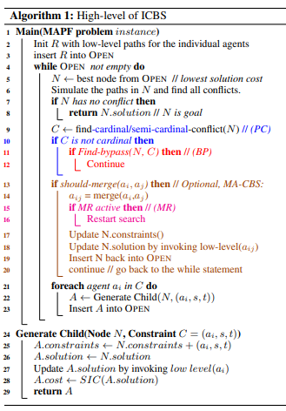
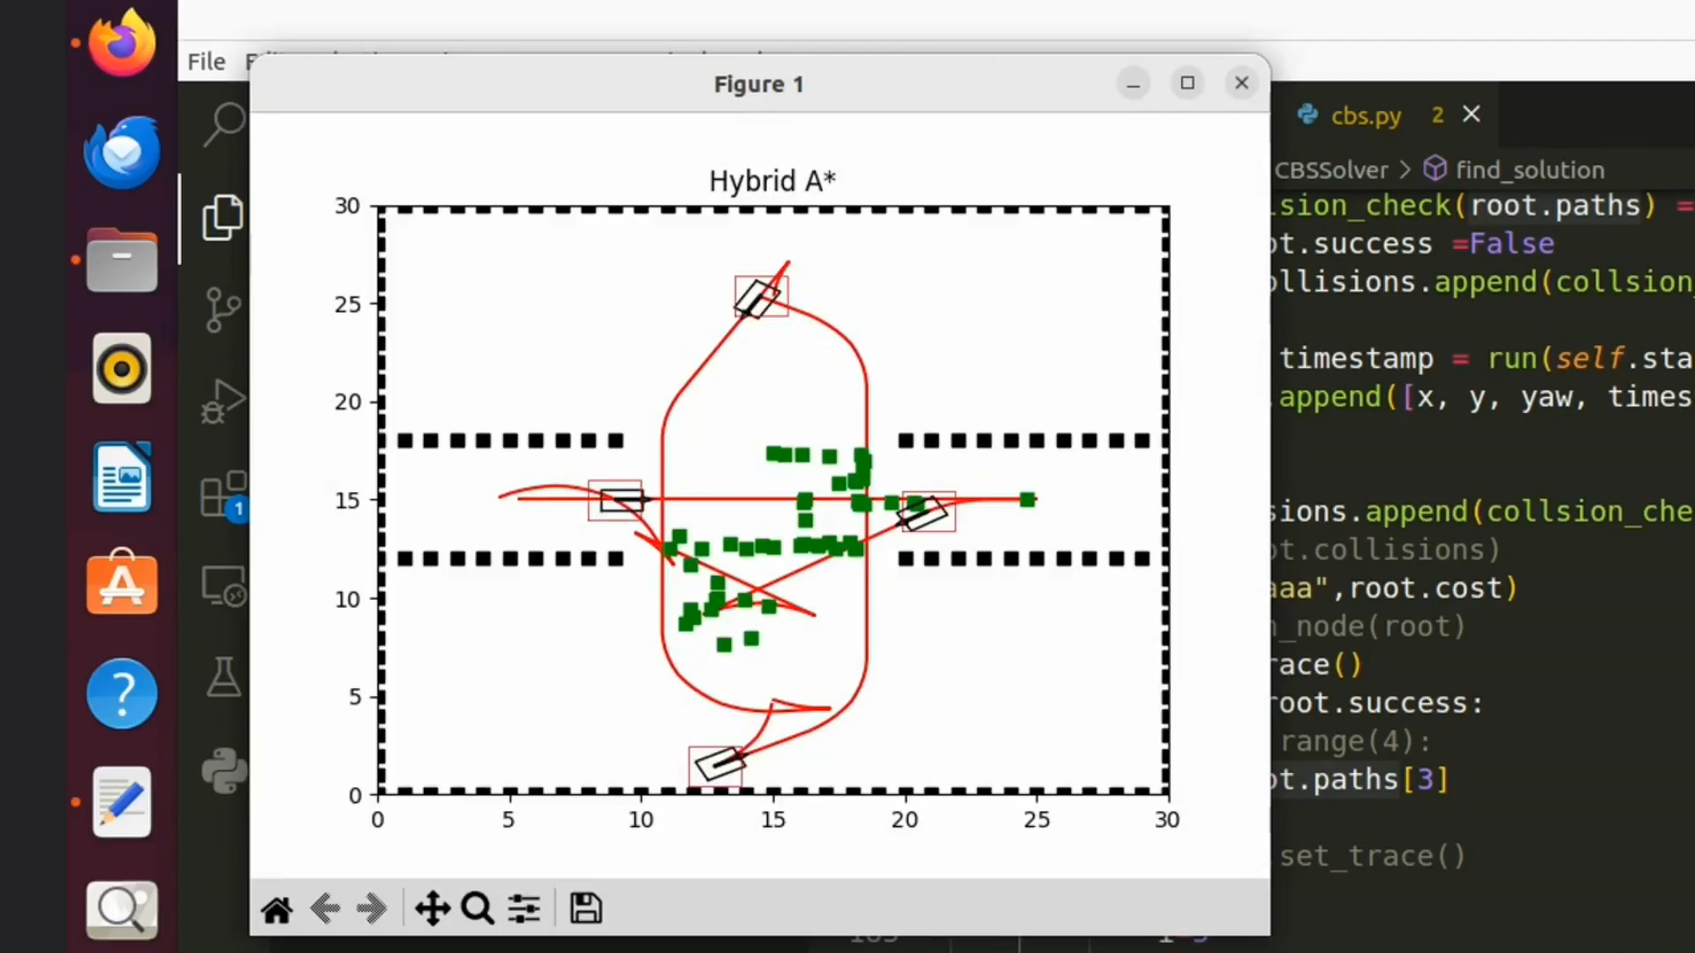
ICBS Implementation
Conflicts, Prioritizing agent, Bounding Box

Slide 8

Results

Slide 9
Results
Path Optimality:
Paths found for holonomic agents were optimum paths for given start and goal locations after resolving conflicts.
Paths found for non-holonomic agents were sub-optimum paths for given start and goal locations after resolving conflicts.
Conflict resolving:
Paths found for holonomic as well as non-holonomic agents were without conflicts for all the cases with 100% success.
Completeness:
Paths found for holonomic agents guarantee finding a solution if one exist.
Paths found for non-holonomic agents doesn't guarantee finding a solution.

Slide 10
Challenges, Obstacles and Successes
Navigating Challenges in Holonomic Point Robots
Algorithm Scalability
Limited Collision Consideration in Diagonal Movements
Continuous Movement for Non-Holonomic Point Robots
Partial Robot Exploration near Obstacles
Continuous Movement Oscillations and Convergence Issues
Differential Drive Non-Holonomic Robots
Geometry-aware Collision Avoidance

Slide 11
Conclusion and Future Scope
Conclusion
The Improved Conflict based algorithm works efficiently with the non- holonomic constraint to provide a collision free path.
Future Scope
Develop autonomous mobile robots that can navigate to dynamic pick-up locations while safely interacting with other robots as moving obstacles.
Implement intelligent algorithms to select pick-up locations based on robot positions and tasks, optimizing system efficiency and robot utilization.

Slide 12
Contributions:
Setting basic Environment and Literature Review | Shambhuraj , Prasanna, Shreya
Implementing A-star and Hybrid A-star | Shambhuraj and Prasanna
Implementing holonomic CBS | Shambhuraj and Shreya
Adding non-holonomic constraint | Shambhuraj and Prasanna
ARGoS Simulation | Prasanna and Shreya
Final Report conclusion and inferences | Prasanna, Shreya and Shambhuraj

Slide 13
References
Y. Shi, B. Hu, and R. Huang, ”Task Allocation and Path Planning of Many Robots with Motion Uncertainty in a Warehouse Environment,” in 2021 IEEE International Conference on Real-time Computing and Robotics (RCAR), 2021, pp. 776-781.
[5] J. Li, D. Harabor, P. J. Stuckey, A. Felner, H. Ma, and S. Koenig, “Disjoint Splitting for Multi-Agent Path Finding with Conflict-Based Search”, in ICAPS, vol. 29, no. 1, pp. 279-283, May 2021.
A. Bolu and ̈O. Korc ̧ak, ”Path Planning for Multiple Mobile Robots in Smart Warehouse,” in 2019 7th International Conference on Control, Mechatronics and Automation (ICCMA), 2019, pp. 144-150.
G. Sharon, R. Stern, A. Felner, N. Sturtevant, ”Conflict-Based Search for Optimal Multi-Agent Path Finding,” in Proceedings of the Twenty- Sixth AAAI Conference on Artificial Intelligence, pp. 563-569, Toronto, Ontario, Canada: AAAI Press, 2012.
E. Boyarski et al., “ICBS: The Improved Conflict-Based Search Algo- rithm for Multi-Agent Pathfinding,”

Slide 14
Thank You !
Notes:
This PowerPoint Template includes a series of slide masters with predefined layouts and color schemes for formatting slides
Slide Masters are displayed when you right click on a slide and select Layout from menu

Slide 15

Current Progress:
Completed with Simulation Environment setup in ARGoS/matplotlib.

Slide 16
Challenges and Successes:
Heuristic Selection: Choosing an appropriate heuristic function (also known as the "h-value") is crucial for the efficiency and correctness of the A* algorithm. The heuristic should be admissible and consistent.
Algorithm writing: During our simulation, there were multiple edge test cases for which we could observe undesirable motion of agents. The reason initial considering robot as point bot.
Integration of algorithms: When incorporating the A* low-level algorithm into the ICBS, which is a high-level algorithm, we are encountering difficulties. We are currently working on it.
Simulation: Learning and implementing the env and simulation in ARGoS was a learning curve.

Slide 17
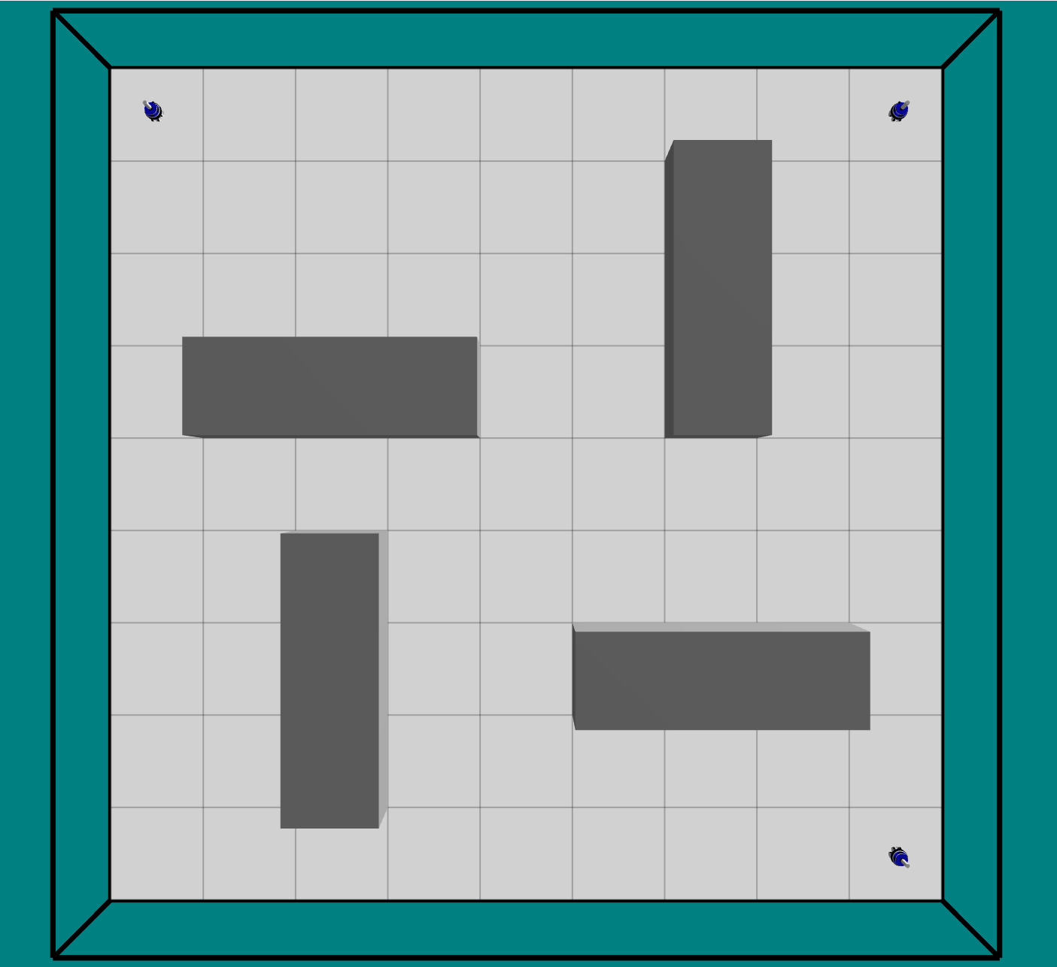
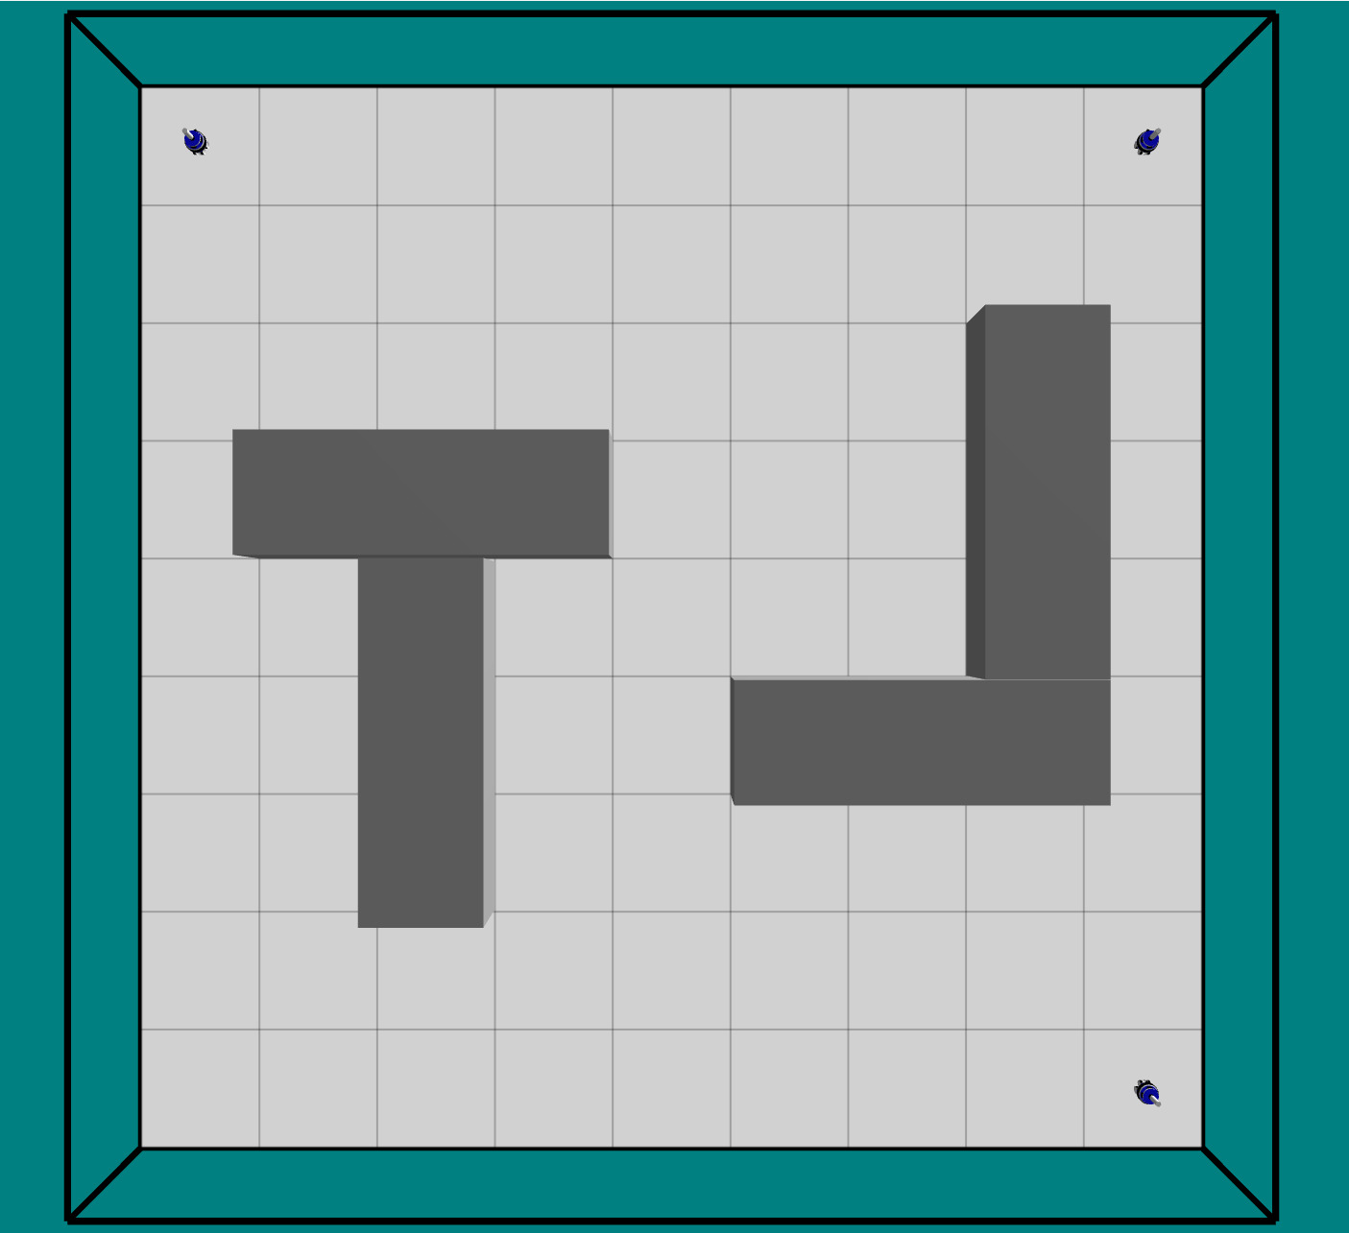
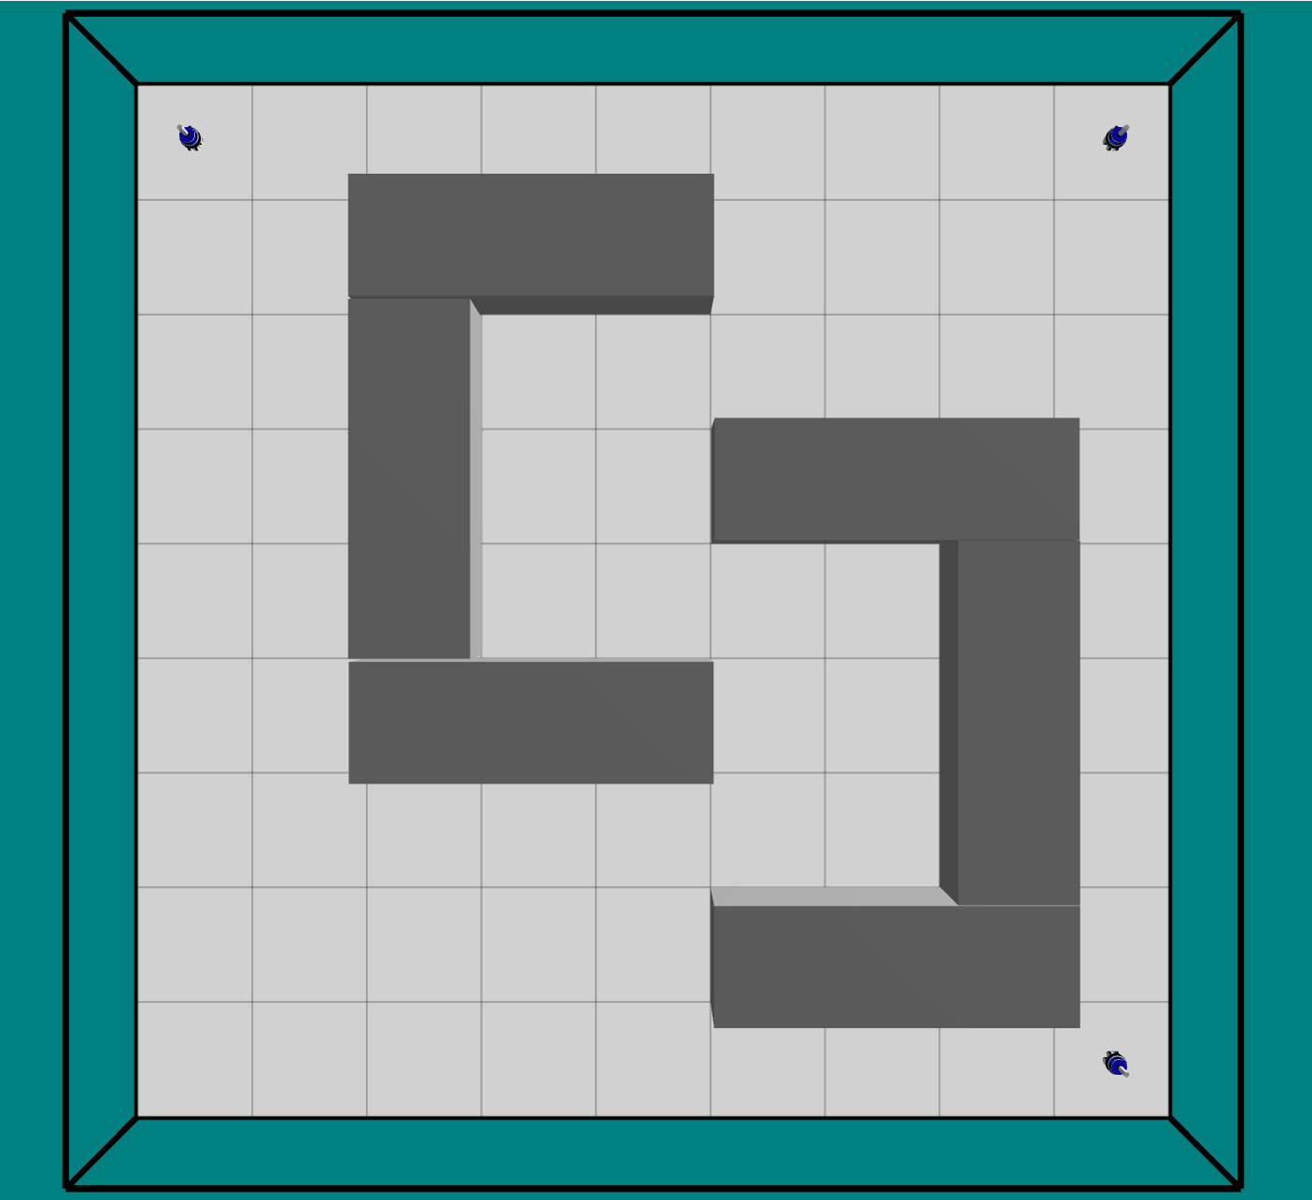
Current Progress:
Approach:To accomplish this goal, we will be employing a 2D simulation environment (replicating real-world warehouse) and implement CBS and ICBS (Improvised Conflict-Based Search) that enables multiple agents to navigate environment, while avoiding collisions.
Env1 Env2 Env3

